Slide 1
Zeyad Abduction Analysis
2_18_26

Slide 2
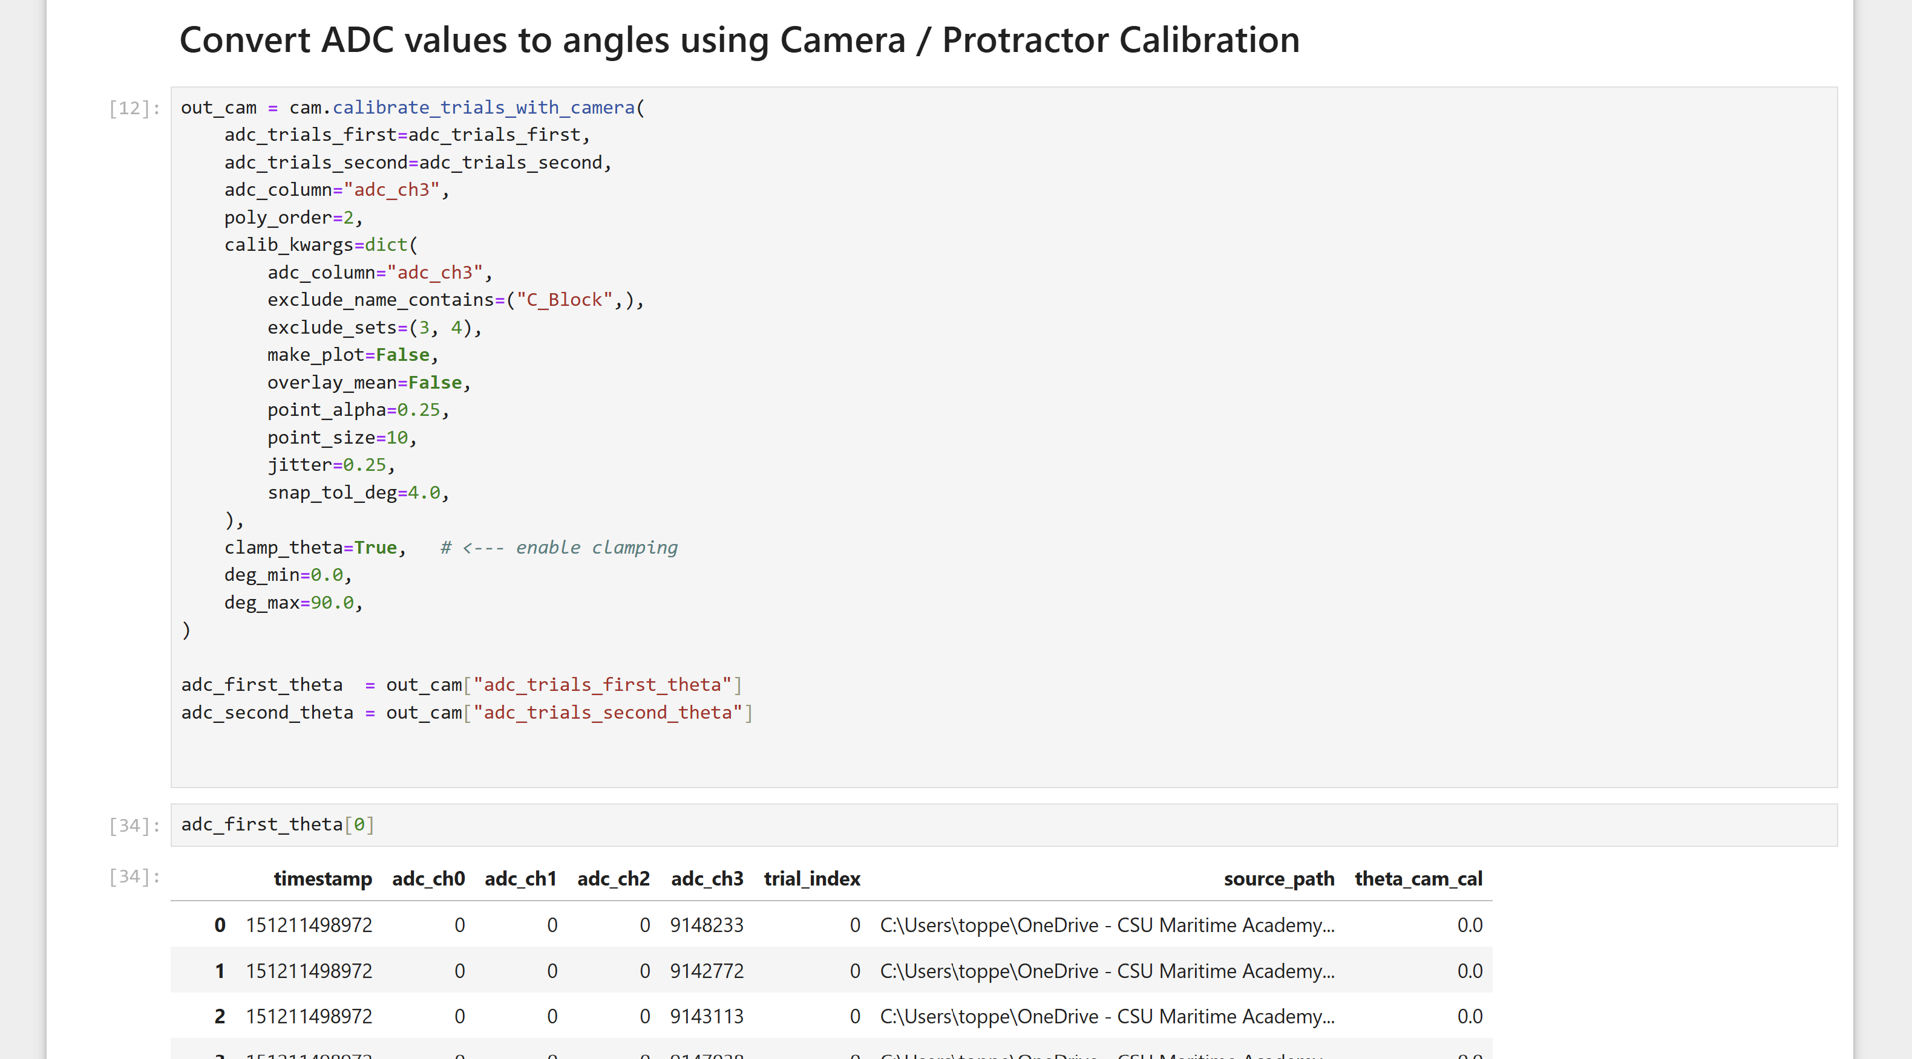
First Application Data
Second Application Data
First Application Data, first trial (3 trials in total: 0, 1, 2)-> (Pandas DataFrame)
theta_cam_cal: ADC Data converted to angles with calibration curve

Slide 3
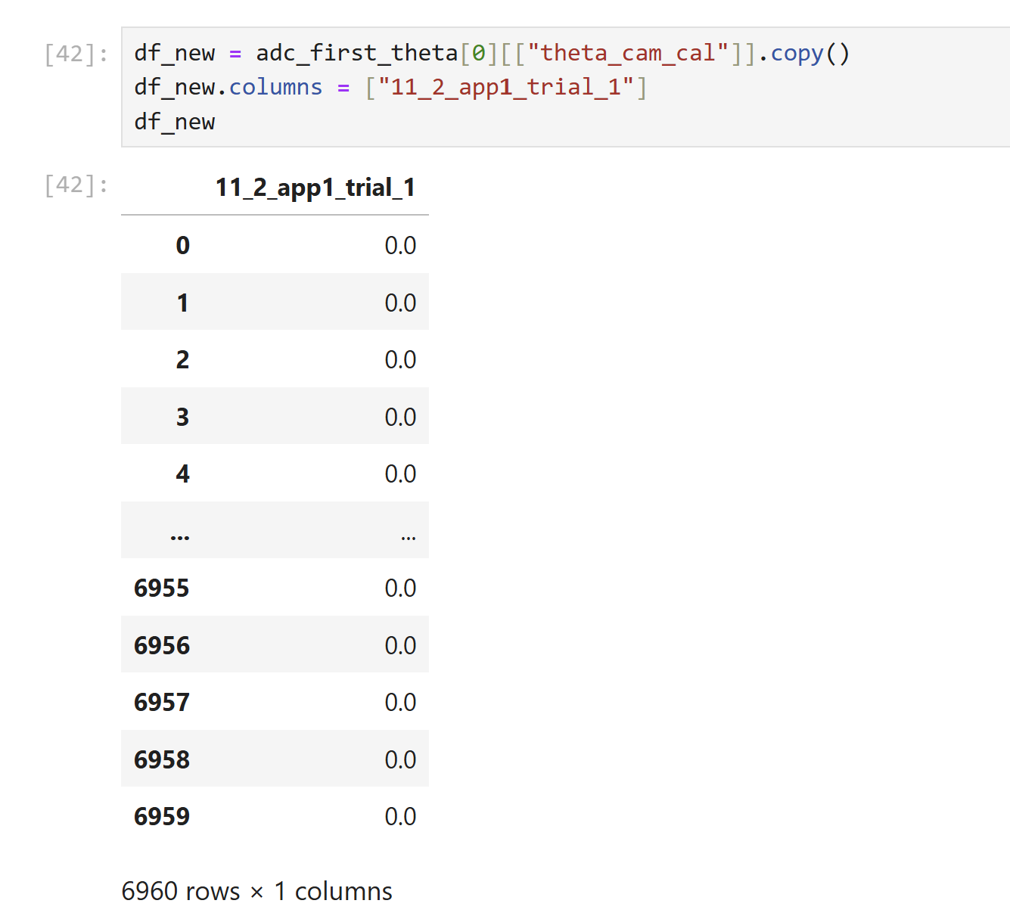
theta_cam_cal: ADC Data converted to angles with calibration curve
theta_cam_cal is a column within the adc_first_theta[0] Pandas Dataframe
You could create a new pandas dataframe and copy that column into it:
df_new = adc_first_theta[0][["theta_cam_cal"]].copy()
Give that column a new name:
df_new.columns = [“11_2_app1_trial_1"]

Slide 4
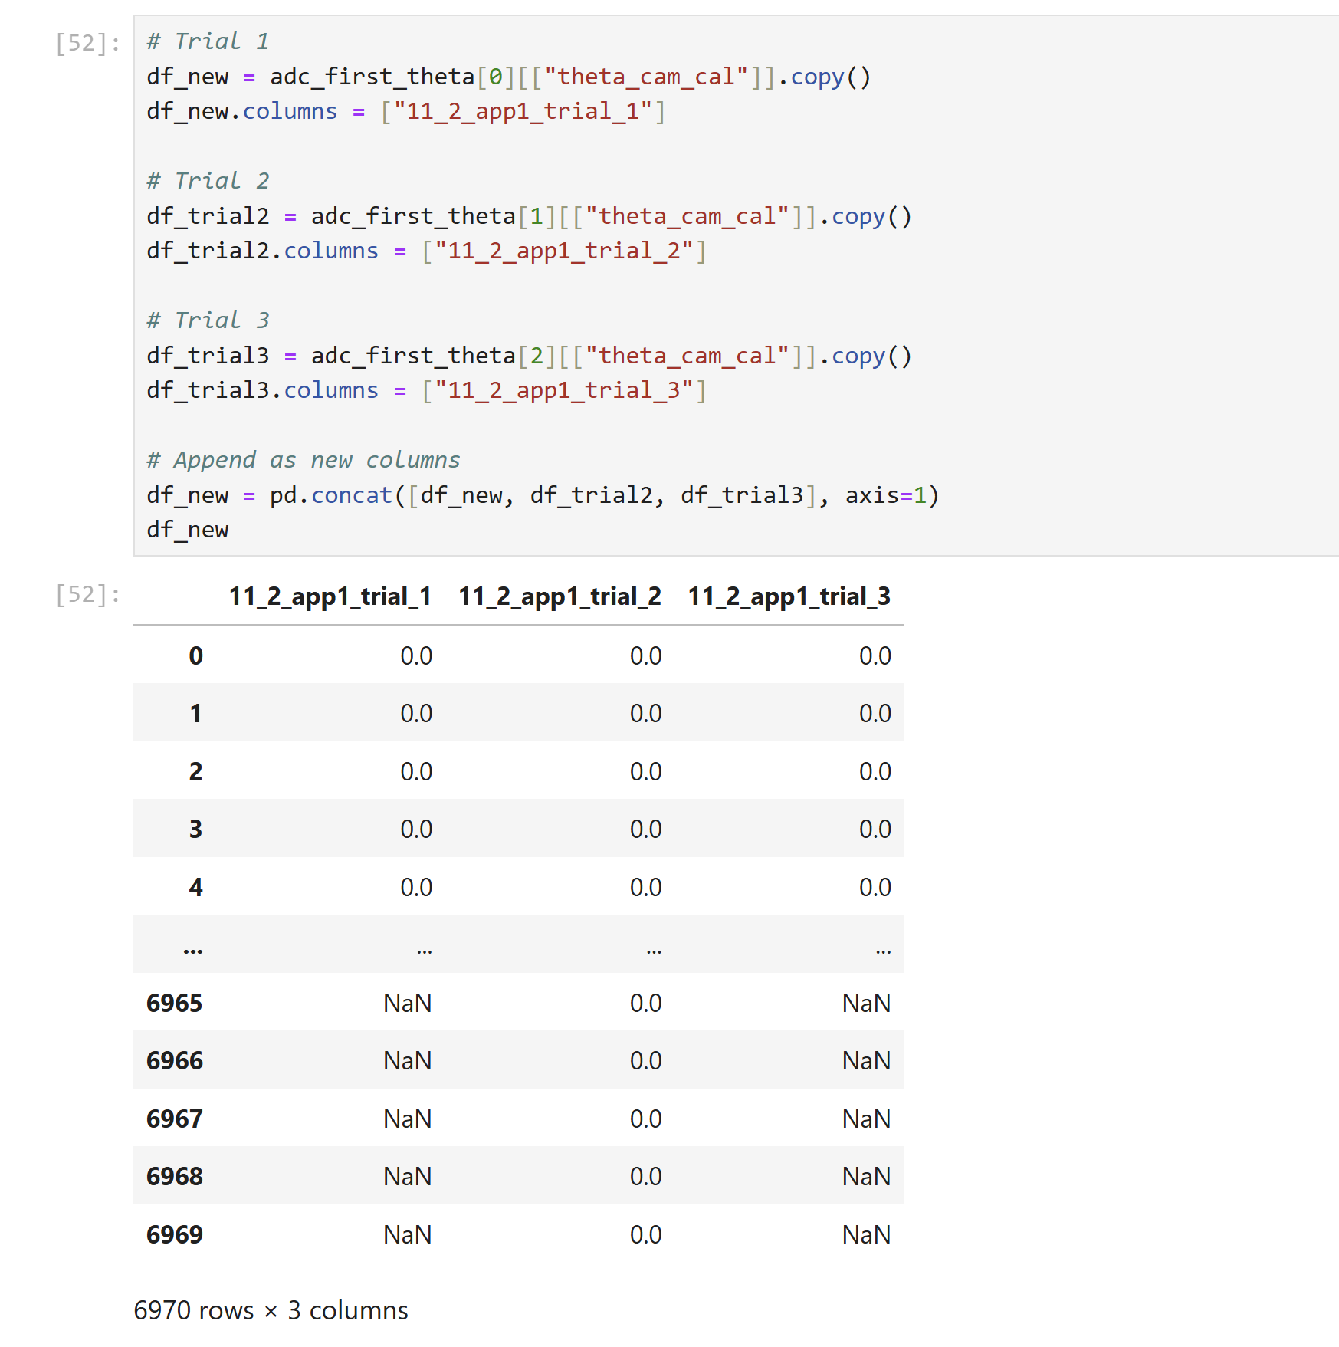
Append Trial Columns

Slide 5
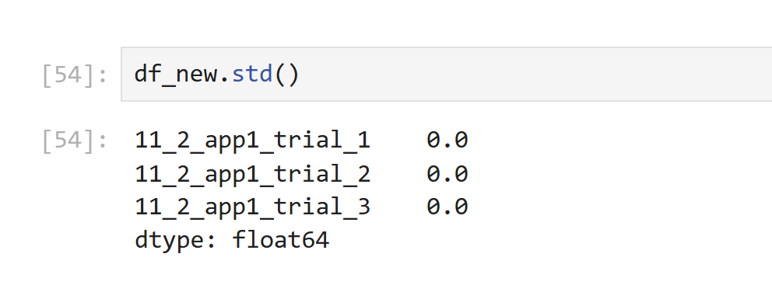
Example of Taking Standard Deviations per column

Slide 6
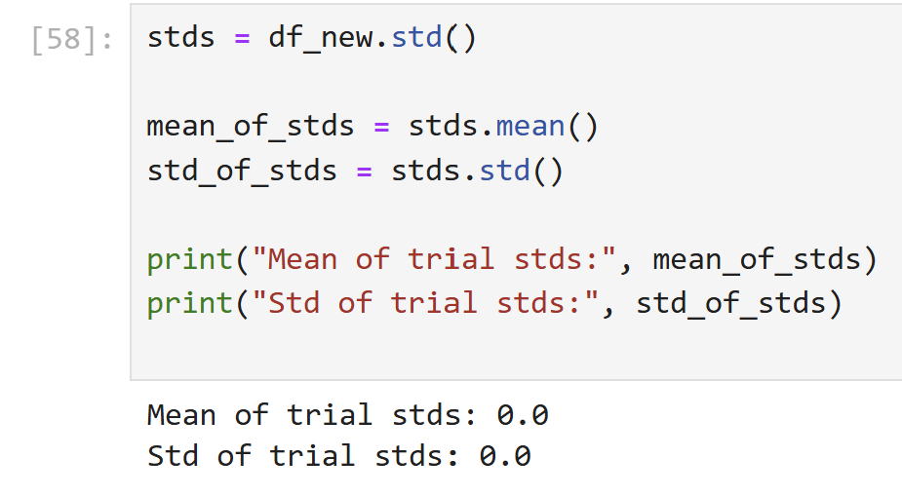
Take Mean and Std of column Std’s

Slide 7
So Overall Plan
Each Participant will have 2 applications and 3 trials per application
Within each trial there should be two distinct regions:
(1) Rest region
(2) Abduction moving region -> cycle 0 to 20 deg
We want to compare overall region of non-moving to moving
We can accomplish that by doing the following:
Take std of non-moving regions AND moving regions for each participant/application/trial
put all those std’s into a new dataframe
We will do a stat/hypothesis testing significance analysis where we compare non-moving region for all participants to moving region
Question is: Does abduction significantly affect changes in angle measurement?

Slide 8
Videos
We need to be able to clearly identify regions/timestamps/frames in videos where movement begins
Each trial lasted exactly 10 sec because that is how we programmed the daq code in Rpi
Video Frame Extractor Code: Google how to do this

Slide 9
Zeyad Abduction Analysis
3_5_26

Slide 10
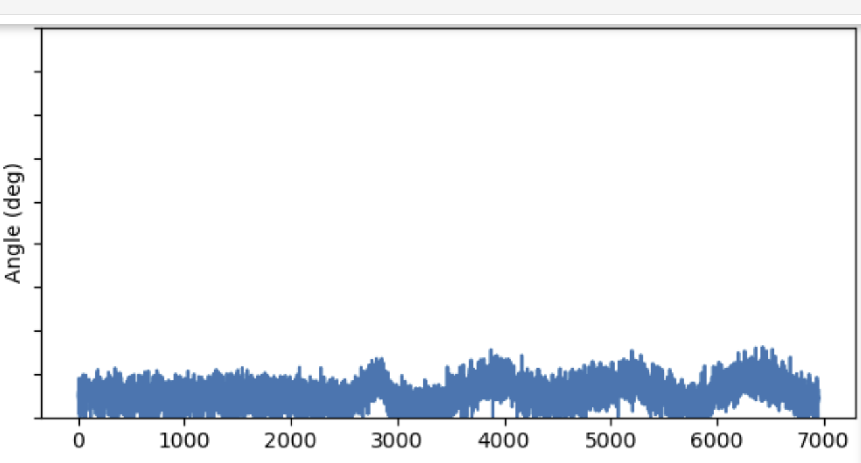
1. Conver x-scale to 0-10 sec for each application, trial, participant. Take 10 sec and divide by total number of data in trial, and that will give a time for each data point.
2. Try re-plotting all applications / trials with vertical line separating non-moving from moving section. Should look something like below.
3. Split each set of data to non-moving and moving data and take std of each. Put those std values into new data frame where column 0 might be participant, column 1is application 0 or 1, column 2 is trial # (0,1,or 2). Column 3 is std of non-moving. Column 4 is std of moving.

